Slide 1
Beneficiary Benefits

Slide 2
Beneficiary Benefits
Learn about the three systems where a member can list a beneficiary
Importance of designating/updating beneficiaries
Guide on how to designate a beneficiary in each system (NYCAPS, NYCERS, DC37)

Slide 3
Three Separate Systems
There are three separate systems that provide members with death beneficiary benefits:
NYPD through (NYCAPS)
NYCERS
Union (DC37)

Slide 4
Three Separate Systems
It is important to:
Designate a beneficiary
Keep this beneficiary updated when you have a change of status
Divorce, marriage, children, death of a previously listed beneficiary, etc.

Slide 5
Three Separate Systems
Currently, ~39,000 NYPD members do not have beneficiaries listed in NYCAPS.
If the member passes away, their loved ones will not be able to easily access the member’s vacation time, comp time, sick time, or any other applicable funds. The member’s family will have to pay costly legal fees to do so.

Slide 6
NYPD Beneficiary Benefits
As an employee of the City of New York, in the event of your death, your family members or other persons of your choice may receive a cash benefit representing all or some of your:
Unused annual leave
Compensatory time
Accrued sick leave
They may also receive a death benefit if your death results from an injury occurring in the course of your employment through no fault of your own.
NYCAPS provides a form to designate as beneficiaries the persons who you wish to receive those payments

Slide 7
NYPD Beneficiary Benefits
If you do not designate a beneficiary in NYCAPS, any such payment will be paid to your “estate.”
That means that the money will be distributed in accordance with the instructions in your Will, if you have one, or pursuant to an order of a Court under the laws of the State in which you reside, if you do not have a Will.

Slide 8
NYPD Beneficiary Benefits
For all Non-Managerial employees:
The lump sum cash payment for accrued annual leave and accrued compensatory time and any Accidental Death Benefit of $25,000 that are to be paid upon death.
As per Mayor’s Executive Order No. 34 dated March 26, 1971, and Labor Relations Order No. 74/46 and its successors

Slide 9
NYPD Beneficiary Benefits
For all Managerial employees:
The lump sum cash payment for accrued annual leave, accrued sick leave and accrued compensatory time and any Accidental Death Benefit of $25,000 that are to be paid upon death.
As per Personnel Order No. 88/5, as amended

Slide 10
NYCAPS: Adding Beneficiary

Slide 11
NYPD: Adding Beneficiary

Slide 12
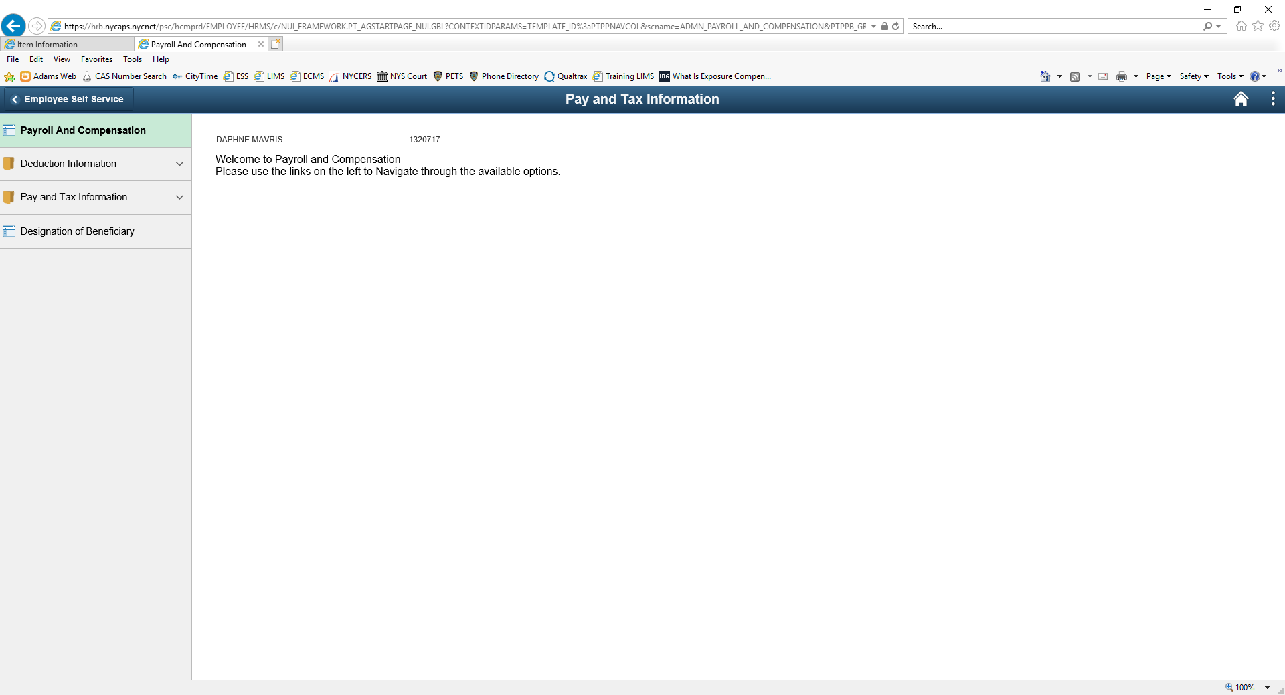
NYPD: Adding Beneficiary

Slide 13
NYPD: Adding Beneficiary

Slide 14
NYPD: Adding Beneficiary

Slide 15
NYCERS: New Logo

Slide 16
NYCERS: Beneficiary Benefits
The details of this benefit depend on which Tier you are in.
Check the NYCERS website for details regarding the Death Benefits for your specific Tier.

Slide 17
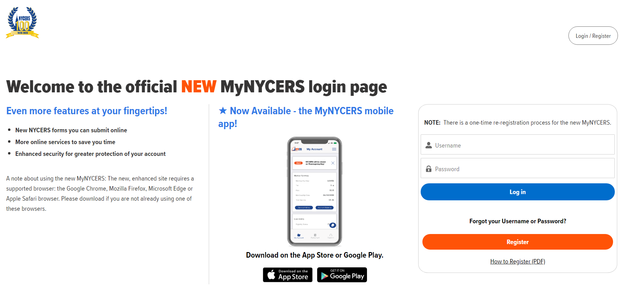
NYCERS: Adding Beneficiary

Slide 18
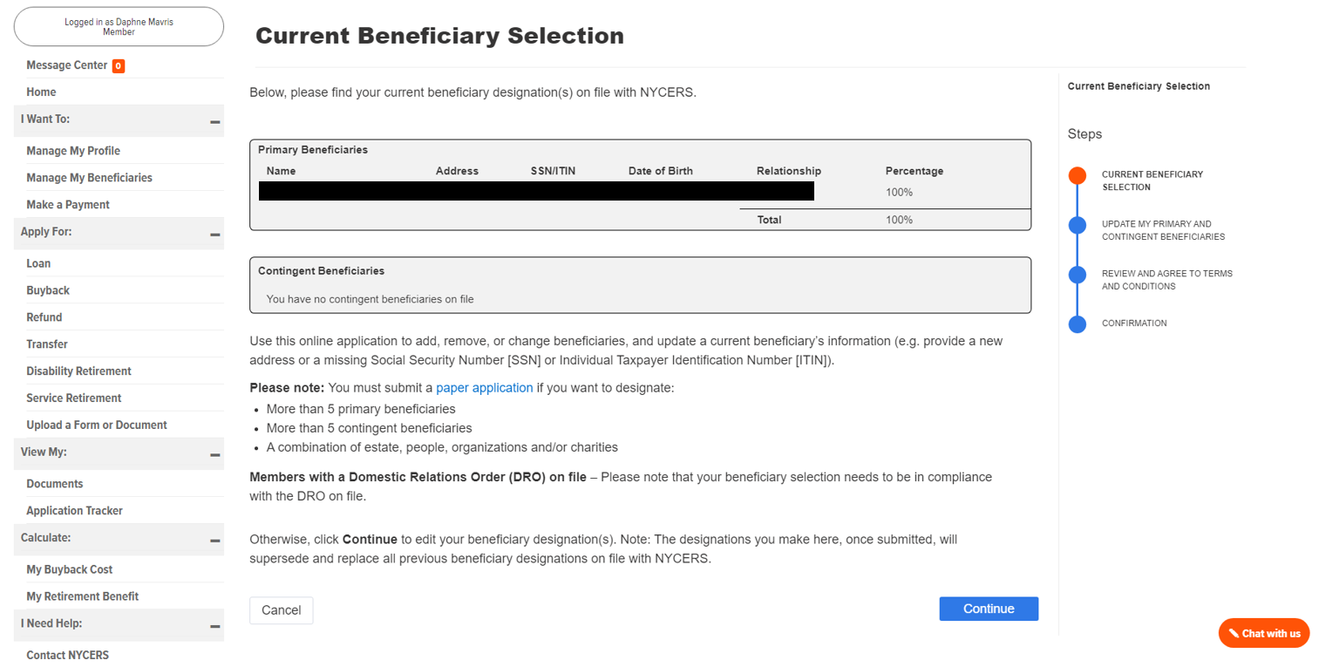
NYCERS: Adding Beneficiary

Slide 19
NYCERS: Adding Beneficiary

Slide 20
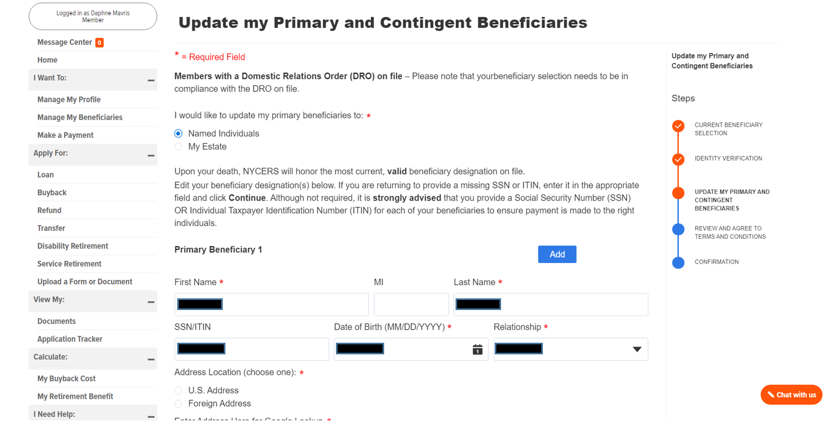
NYCERS: Adding Beneficiary

Slide 21
NYCERS: Adding Beneficiary

Slide 22
DC37: Beneficiary Benefits
If an active employee covered by the Plan dies, a Death Benefit of $10,000 for a full-timer or $6,000 for a part-timer will be paid to his/her beneficiaries.
Effective 1/1/2010, if an eligible retiree covered by the Plan dies, a Death Benefit of $2,000 will be paid to his/her beneficiaries. The retiree Death Benefit for the Cultural Trust remains at $1,000
https://www.dc37.net/benefits/health/death

Slide 23
DC37: Beneficiary Benefits
The Death Benefit is paid to the person or persons selected by the member on his/her enrollment card or Change of Beneficiary card filed with the Plan office.
The member can change beneficiaries whenever he/she wishes – as long as it is done on the proper Change of Beneficiary form. As soon as the new form is received by the Plan office, it becomes effective and voids any previous designations.
https://www.dc37.net/benefits/health/death

Slide 24
DC37: Beneficiary Benefits
If a member names more than one beneficiary, the Death Benefit will be divided equally among them unless the member indicated otherwise. If children are named, and they are under 18 years of age at the time of the member’s death, a custodial letter will be given to the child’s surviving natural parent, if the child lives with that parent.
If no natural parent survives, guardianship papers will be requested of the adult individual who has custody of the infant beneficiary. The benefit will be paid to the guardian and will be subject to the control of the court until the child/children is 18 years old.
https://www.dc37.net/benefits/health/death

Slide 25
DC37: Beneficiary Benefits
If there are no living beneficiaries or if the member does not name any beneficiaries, the total benefit will be paid according to the rules and regulations of the Plan.
https://www.dc37.net/benefits/health/death

Slide 26
DC37: Beneficiary Benefits
There is also:
Accidental Death and Dismemberment Benefit
Extended Death Benefit
Expanded Death Benefit
Survivor’s Benefit
Please visit https://www.dc37.net/benefits/health/death for details regarding these plans
https://www.dc37.net/benefits/health/death

